Slide 1
The Product Company
Data Mart Development
ISTE 724 Data Warehousing

Slide 2
Team Members
Abhishek Shakwala
Dwiz Kumar
Rinkesh Shah
Waleed Mohammed Mastour

Slide 3
Agenda
Design of Data Mart
Dimensional Model
Data Extraction
Data Cleaning and Transformation
Slowly Changing Dimensions
End User Applications

Slide 4
Design of Data Mart
Universe of Discourse:
Scope of our data mart is to investigate financial performance of TPC-E, TPC-W and PEC based on the product sales, gross profit and costs on an annual, quarterly, monthly, or weekly basis
Data Mart helps in optimizing the financial control of company by keeping cost down and better manage relationship with the suppliers.

Slide 5
Information Package
Product_DIM | Customer_DIM | Supplier_DIM | Date_DIM | Method_DIM
Product_SK | Customer_SK | Supplier_SK | Date_SK | Method_SK
PEC_ProductID | PEC_CustomerID | SupplierID | Date_NK | ShippingMethod
TPCE_ProductID | TPCE_CustomerID | SupplierName | CalendarYear | OrderMethod
TPCW_ProductID | TPCW_CustomerID | Address1 | CalendarQuarter | PaymentMethod
ProductName | CustomerName | Address2 | CalendarMonth
ProductType_ID | CustomerType | City | CalendarWeek
ProductDescription | Address_1 | State | FiscalYear
Price1 | Address_2 | Zip | FiscalQuarter
Price2 | City |  | FiscalMonth
UnitCost | State |  | FiscalWeek
BU_ID | Zip |  | Day
BU_Name
BU_Abbrev

Slide 6
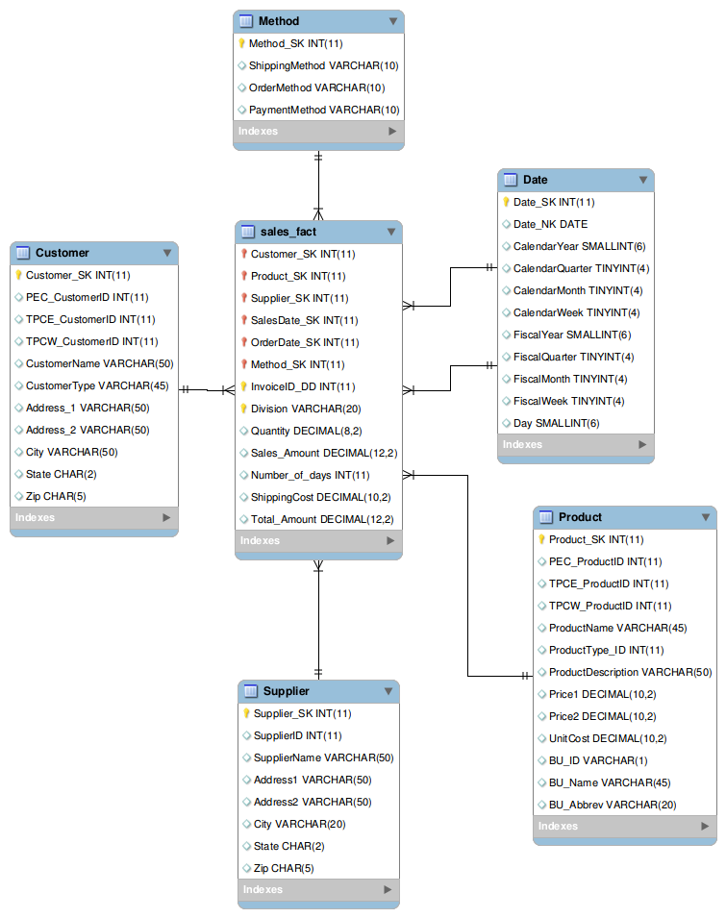
Dimensional Model
Dimension table : Supplier_DIM
Surrogate Key: Supplier_SK
Relationship: Sales_Fact
Cardinality: 1 : N
Dimension table : Product_DIM
Surrogate Key: Product_SK
Relationship: Sales_Fact
Cardinality: 1 : N
Dimension table : Customer_DIM
Surrogate Key: Customer_SK
Relationship: Sales_Fact
Cardinality: 1 : N

Slide 7
Data Extraction
Following are the three sources of data
TPC-E | TPC-W | PEC
customer.csv | TPCWbusiness_unit.csv | PECbusiness_unit.csv
customer_type.csv | TPCWcustomer.csv | PECcustomer.csv
invoice.csv | TPCWcustomer_type.csv | PECcustomer_type.csv
invoice_details.csv | TPCWsales_new.csv | PECsales_new.csv
business_unit.csv | TPCWproduct.csv | PECmanufacturingCosts.csv
product.csv | TPCWproduct_type.csv | PECproduct.csv
supplier.csv |  | PECproduct_type.csv
product_type.csv

Slide 8
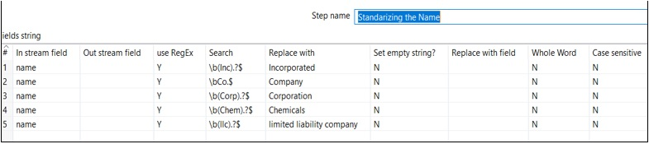
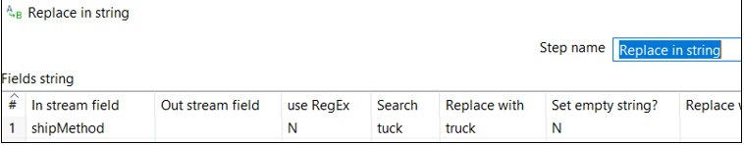
Data Cleaning & Transformation
Name Inc, Co, Corp, Chem, llc converted to Incorporated, Company, Corporation, Chemicals, and limited liability company.
Replace ‘tuck’ to ‘truck’ in the shipMethod.

Slide 9
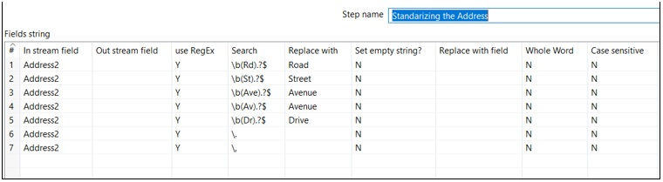
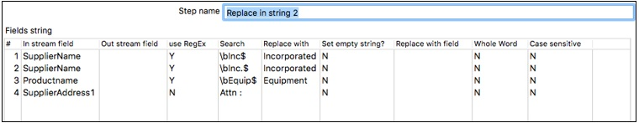
Data Cleaning & Transformation
Address Rd, St, Ave, Av, Dr updated through regex
Changed Equip to Equipment, Inc to Incorporated and removed Attn:

Slide 10
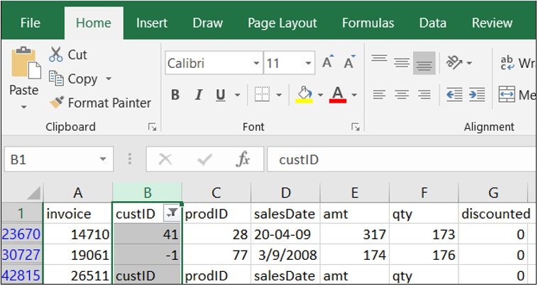
Data Cleaning & Transformation
Removed row having customerID -1, 41, and custID

Slide 11
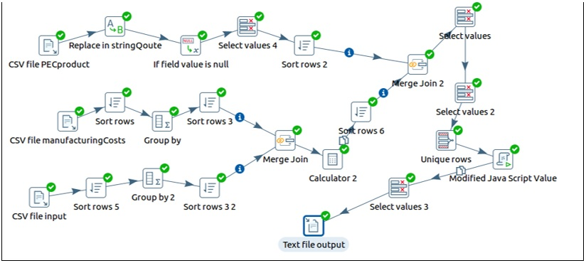
Data Cleaning & Transformation
Product_Unit_Cost_Calculation Kettle

Slide 12
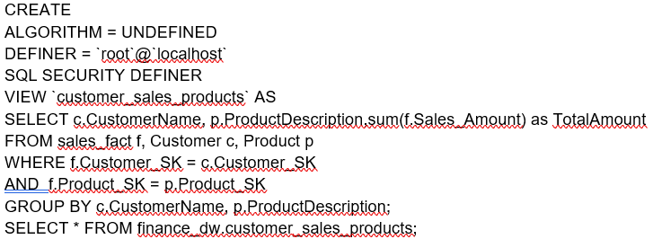
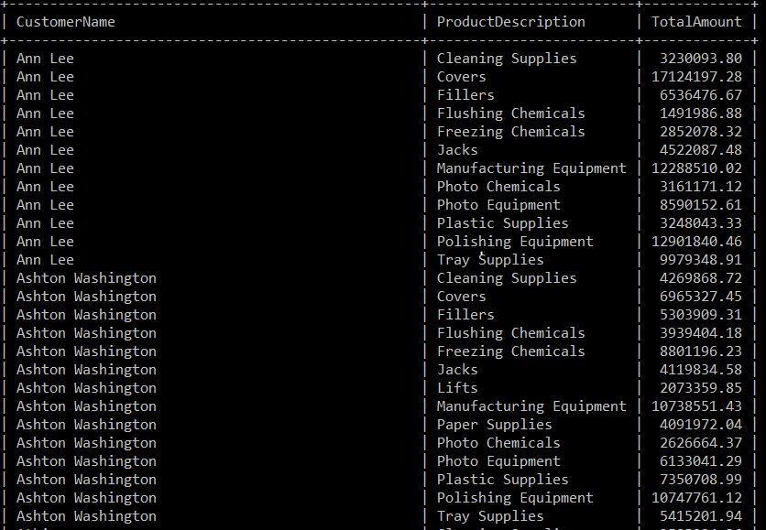
Views & Summarization
Goal: The following view facilitates end
users to get the total amount spent on
the particular type of products by
Customer. Query
Output

Slide 13
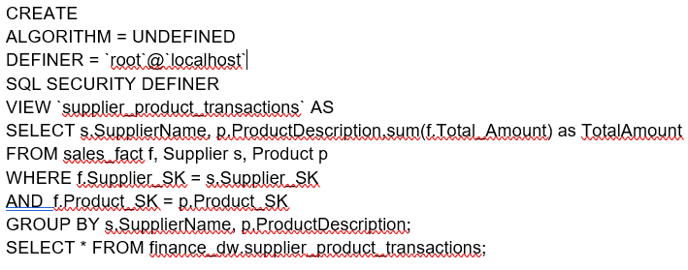
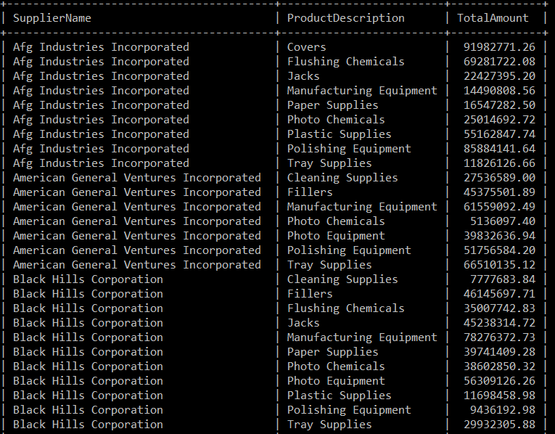
Views & Summarization
Goal: The following view facilitates end users to find the sales made by the supplier along with the quantity of the product sold.
Query
Output

Slide 14
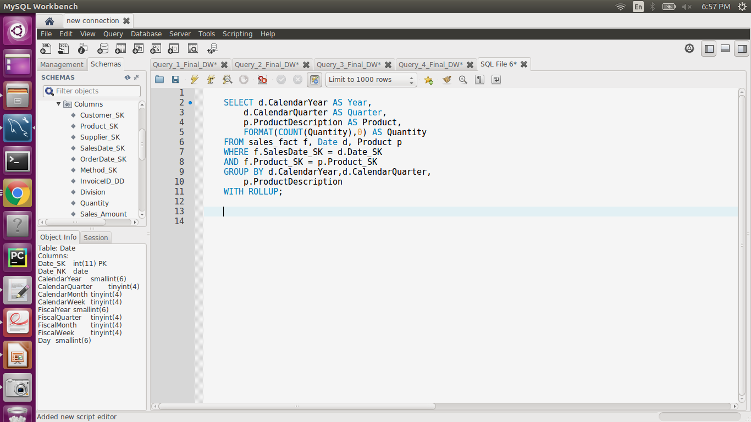
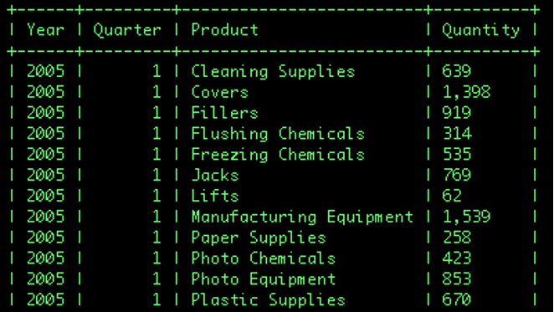
Views & Summarization
Goal: Summarize the quantity of
products sold in every quarter for a
particular year.
Query
Output

Slide 15
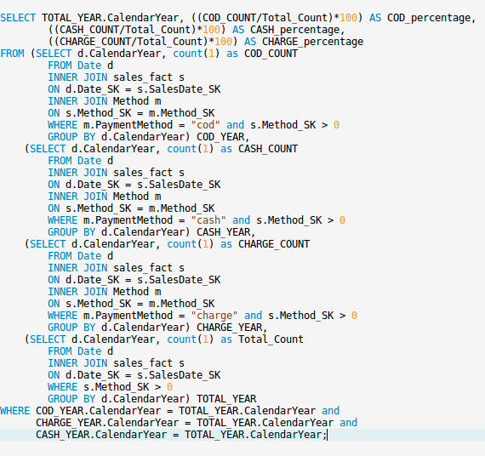
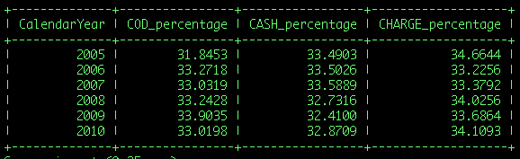
End User Applications
Goal: The percentage of invoices along with payment method year wise comparison.
Output Query

Slide 16
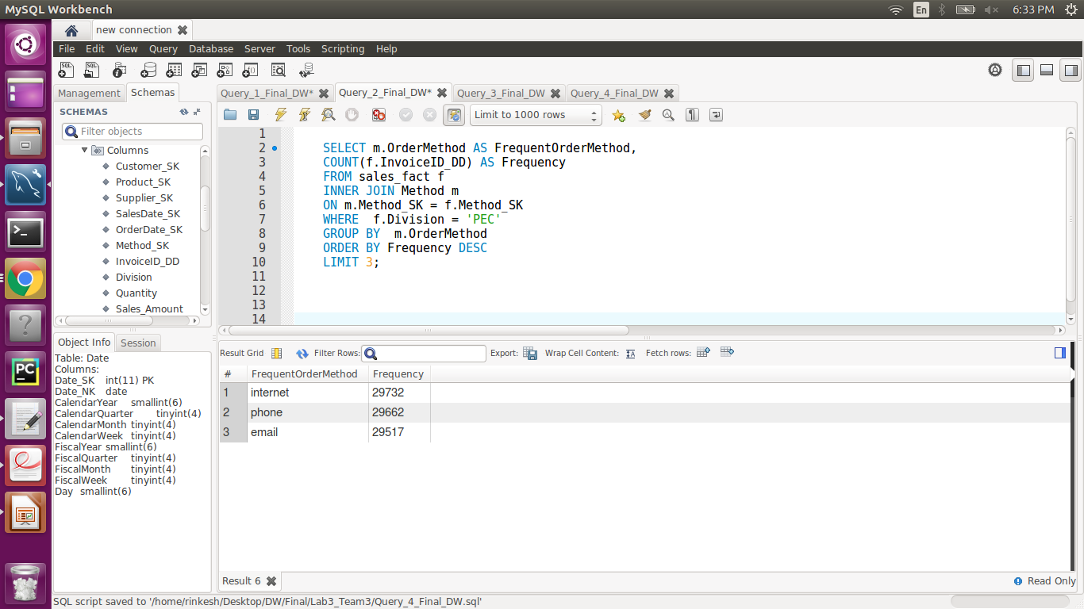
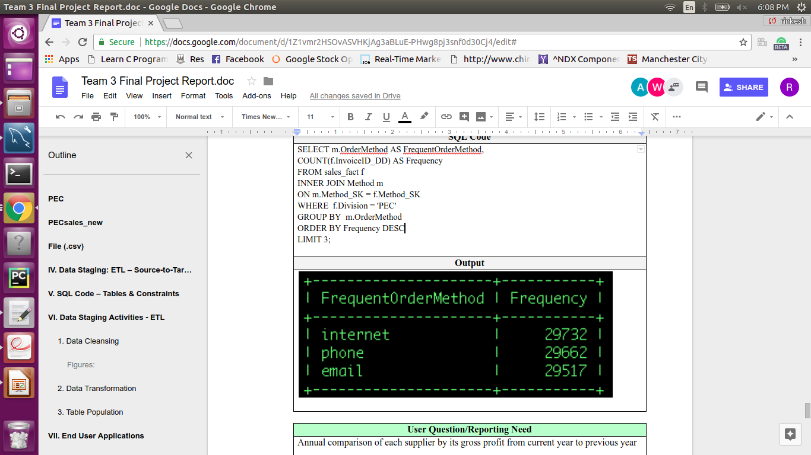
End User Applications
Goal: The most frequent method of ordering a product from PEC.
Query
Output

Slide 17
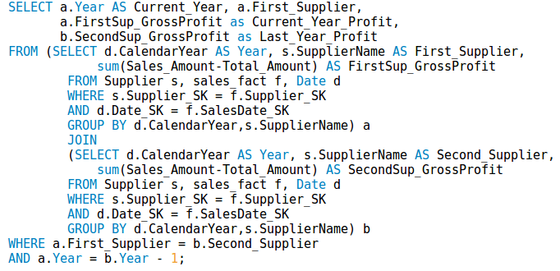
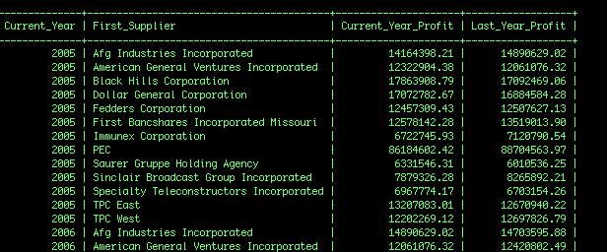
End User Applications
Goal: Annual comparison of each
supplier by its gross profit from current
year to previous year
Query
Output

Slide 18
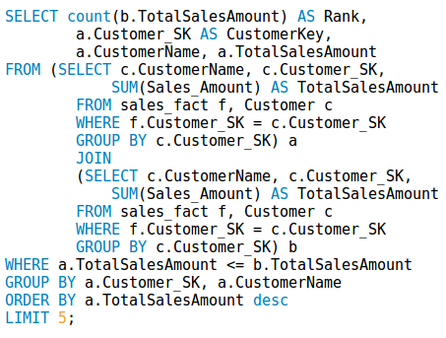
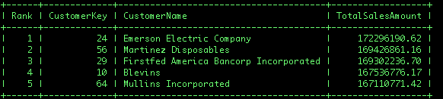
End User Applications
Goal: Top five customers each year
on the basis of total sales amount.
Query
Output

Slide 19
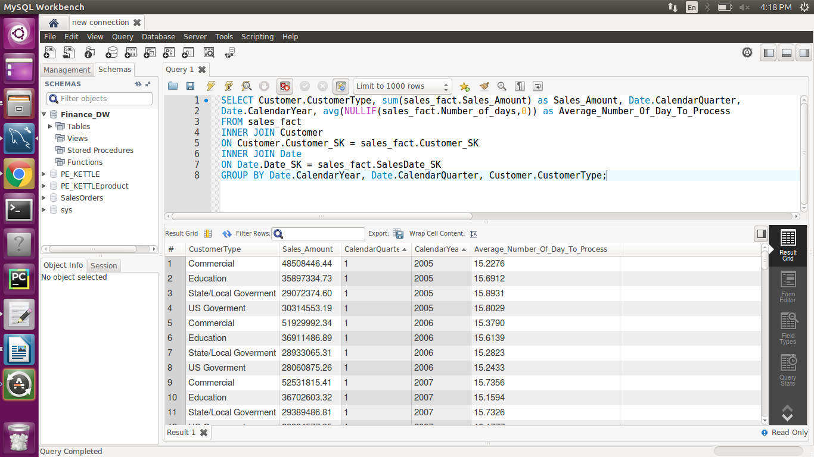
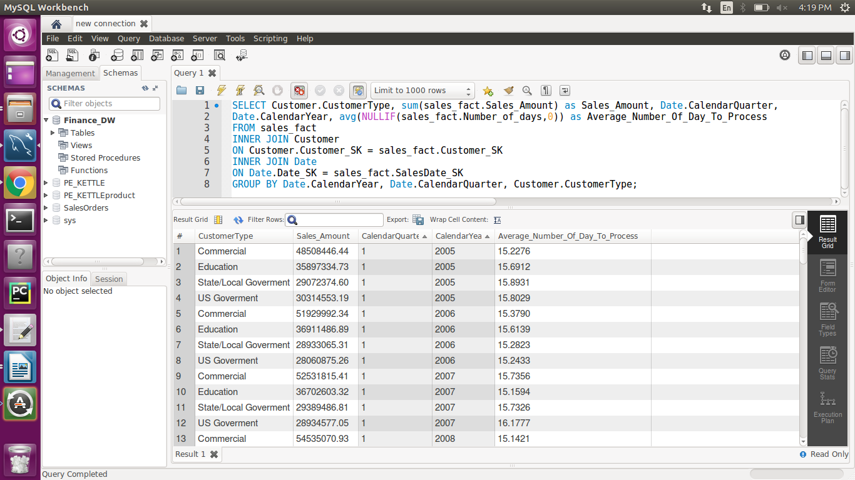
End User Applications
Goal: Find the total sales and average
number of day to ship to the customer
associated with the customer type on
quarterly based.
Query
Output

Slide 20
N:M Implementation
Design Choice
Denormalizing the Dimension Table by Positional-Flag Attributes
Stores a boolean value for a location of each attribute
Will contain boolean attributes for each shipping company
Denormalizing the Dimension Table by Non-Positional-attributes & a Concatenated Field
Fixed number of attributes and each attribute store a different shipping company
Concentrated field which stores all the shipping company in a single attribute

Slide 21
N:M Implementation
Lowering the Grain of the Fact Table
Stores the Shipping SK and Supplier SK in the fact table
Lower the Grain of the Fact Table: Separating Diagnosis from Billing Data
Similar as above method but it store the SK’s in separate fact table

Slide 22
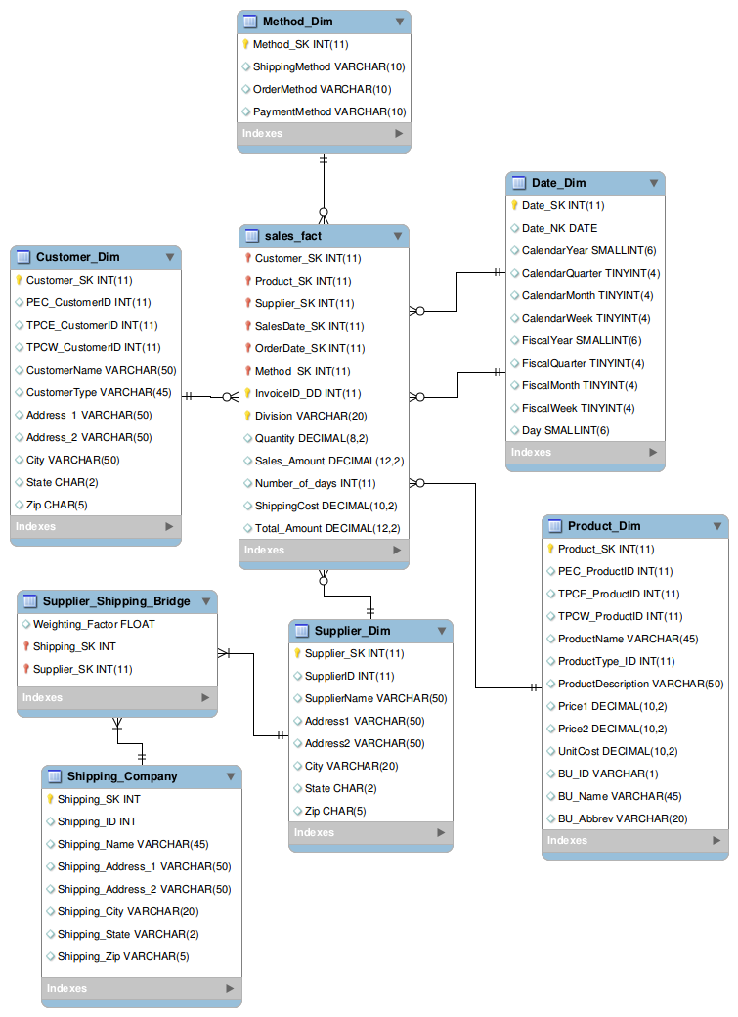
N:M Implementation
The Bridge Table
A Bridge table between Shipping and Supplier containing SK’s and weighting factor
Weighting factor is a percentage that identifies the contribution

Slide 23
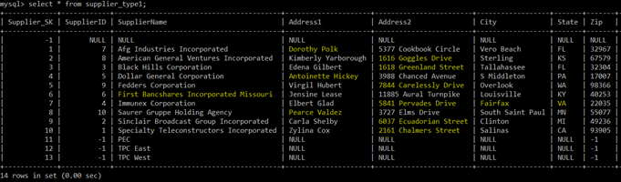
SCD
SCD type-1 (overwrite) - On supplier dimension
Slowly Changing Dimension type 1 is for overwriting erroneous data
Occurs mostly by typo error or due to wrong information
No need to maintain the original value.
No changes are made in dimension table row.
Before SCD

Slide 24
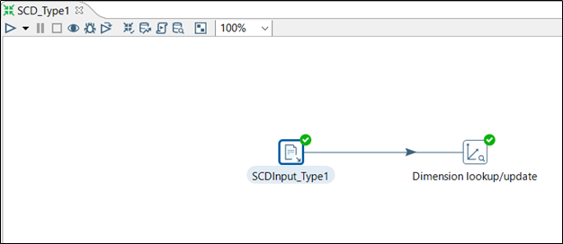
SCD
SCD type-1 : Implementation
Create CSV file that contains updated record.
Changes made on SupplierName, Address1, Address2, City, and Zip.
A dimension lookup for all the rows based on SupplierID. Type of dimension to update should have value update and for others, it has a value of punch-through.
SCD Implementation

Slide 25
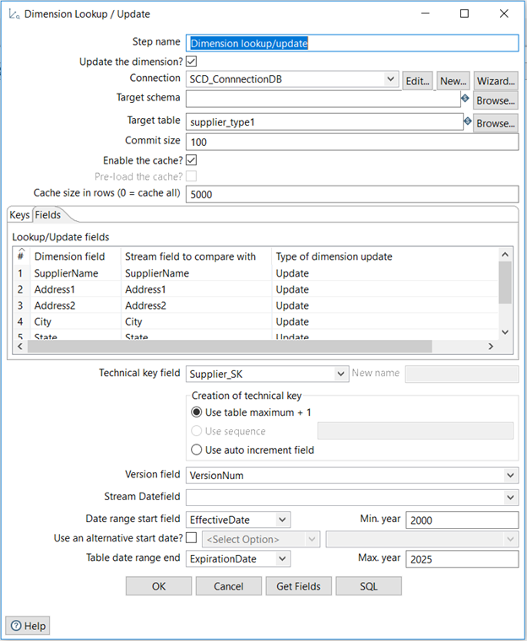
SCD
SCD type-1 : Implementation
SCD Implementation

Slide 26
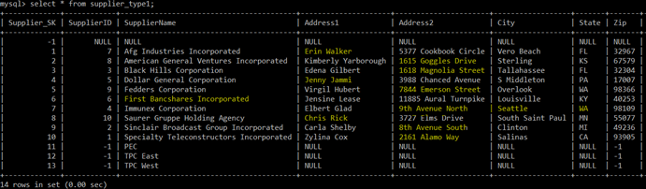
SCD
After SCD
SCD type-1 : Table output after SCD implementation.

Slide 27
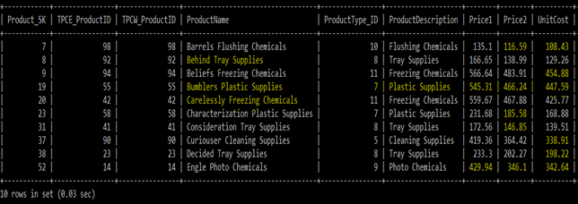
SCD
SCD type-2 (Add a new row) - On product dimension
Slowly Changing Dimension type 2 is for adding new rows for error data that is relevant to the business rule of Data warehousing.
Needs to maintain the original record.
New surrogate key, version number, effective date & expiration date required .
Before SCD

Slide 28
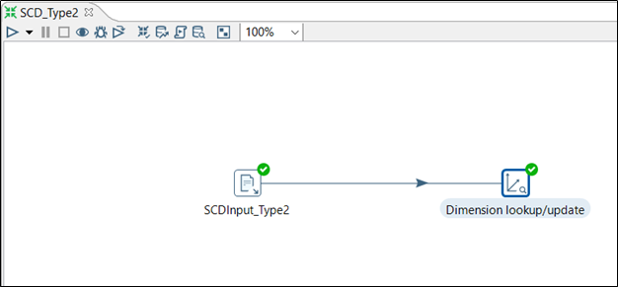
SCD
SCD type-2 : Implementation
Create CSV file that contains updated record.
Changes made on ProductName, ProductDescription, Price1, Price2, and UnitCost.
A dimension lookup for all the rows based on TPCE_ProductID and TPCW_ProductID.
Type of dimension to update should have value insert and for others, it has a value of punch-through. Added VersionNum, EffectiveDate, and ExpirationDate.
SCD Implementation

Slide 29
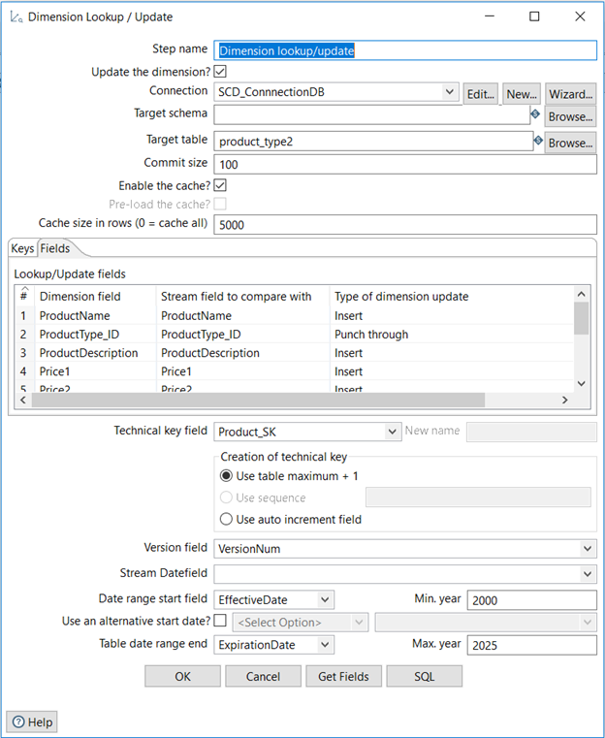
SCD
SCD type-2 : Implementation
SCD Implementation

Slide 30
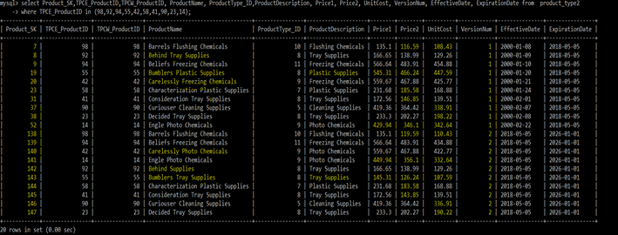
SCD
After SCD
SCD type-2 : Table output after SCD implementation.

Slide 31
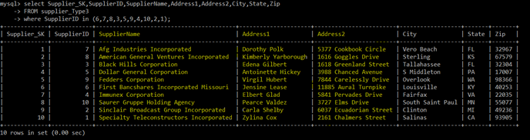
SCD
SCD type-3 (Add a new attribute) - On supplier dimension
Slowly Changing Dimension type 3 is for tentative and soft changes.
Needs to track history both before and after changes.
Add a new attribute column for new value.
Can maintain effective date and expiration date but version number not required.
Before SCD

Slide 32
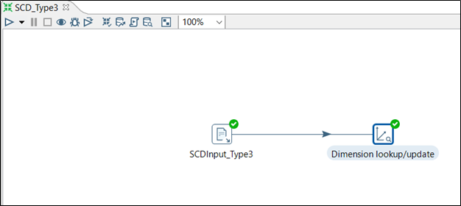
SCD
SCD type-2 : Implementation
Create CSV file that contains updated record.
Changes made for SupplierName, Address1, and Address2. Added new columns.
A dimension lookup for all the rows based on SupplierID.
Type of dimension to update should have value update for new columns and for others, it has a value of punch-through. Added EffectiveDate, and ExpirationDate.
SCD Implementation

Slide 33
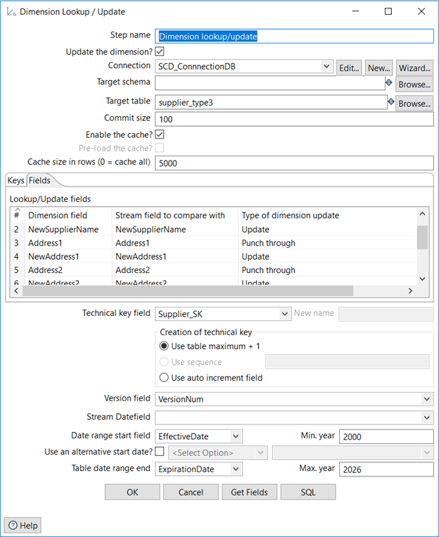
SCD
SCD type-3 : Implementation
SCD Implementation

Slide 34
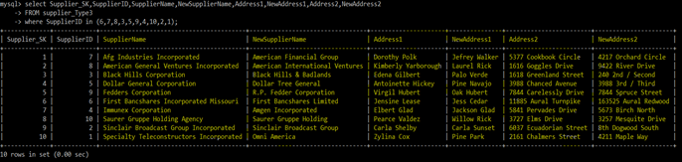
SCD
After SCD
SCD type-3 : Table output after SCD implementation.

Slide 35
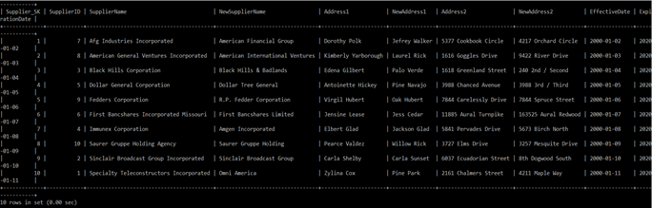
SCD
After SCD
SCD type-3 : Table output after SCD implementation with Effective and Expiration Date.

